Slide 1


SYSTEM
SURVEILLANCE
USING
KEYLOGGER
Project Presentation

Slide 2


Team Members
Mohammad Mushfiqur rahman 192002093

Slide 3
Table of contents
What is keylogging ?
Objectives
Importance of keylogger
Features of keylogger
Pro- Features of keylogger
Modules used
Keylogger Architecture
Block diagram
System Requirements
Program files
Codes
Output
Advantages
Disadvantages
Conclusions

Slide 4
What is keylogging ?
A program or Hardware device that capture every key impression on the system.
Used to monitor user’s activities.
Used to retrieve data and forgotten URLs.

Slide 5
Objectives
Define Key logger
Captures keystrokes
Sends mail to the admin
Monitors the system Activities by others

Slide 6
Importance of keylogger
IT organizations can indicate their concerns by going after the culprit whose performance is deteriorating that of the whole organization.
Keylogger s/w is also available for use on smart phones, such as iPhones and Android .

Slide 7
Features of keylogger
Key stroke
monitoring
Web site visited
Windows startup
Screen shot capturing
Program captured
Startup Alert

Slide 8
Pro- Features of keylogger
Remote viewing email delivery
Log exporting
Optimal stealth
mode
Log Filtering
Customizable
Setting mode
Auto log clearing

Slide 9

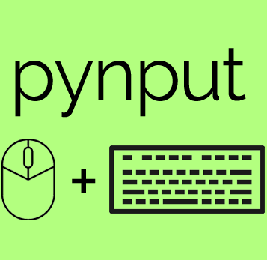


Modules Used
1-SMTPlib:
2-Pynput:
3-Keylogger:
4-Threading:
It is a client session object that can be used to send mail to any internet machine with SMTP domain.
This library allow you to control and monitor input devices.
Surveillance technology used to monitor or record each key stroke
It used to run certain code / processing in background and without consent of user.

Slide 10
Keylogger Architecture
Internet Explorer
FTP module
Application
Application
Hook procedure
Hook procedure
Hook procedure
Main Module

Slide 11
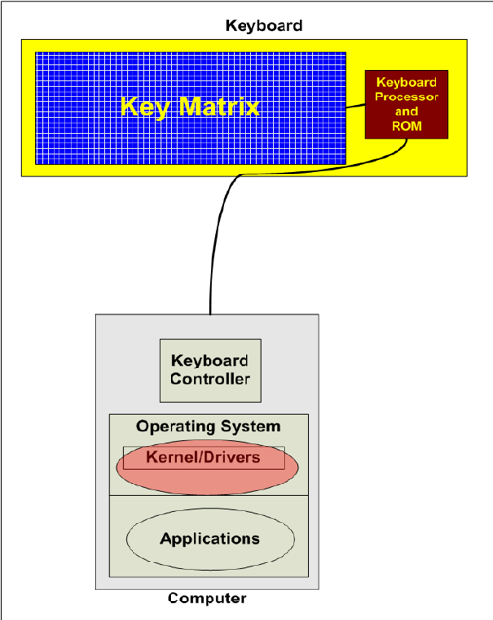
Block diagram
Spyrix Keylogger
Actual Keylogger
Examples of Keylogger
REFOG Keylogger
Revealer Keylogger

Slide 12
System Requirement
Windows XP (32-bit & x64),Windows Server 2003/2008, (32-bit & x64),Windows 7, (32-bit & x64);Windows 10,Windows 2000 or later ,
Internet Explorer 5.0 or later ,monitor : 15” colour,HDD 40GB
Basic input devices required: keyboard
Basic output devices required: mobile devices
S/W requirement: PyCharm, Python 3.8.0 Technologies used: Advanced programming using Python

Slide 13
Program files
execute_keylogger.py
Program files:
Keylogger.py

Slide 14
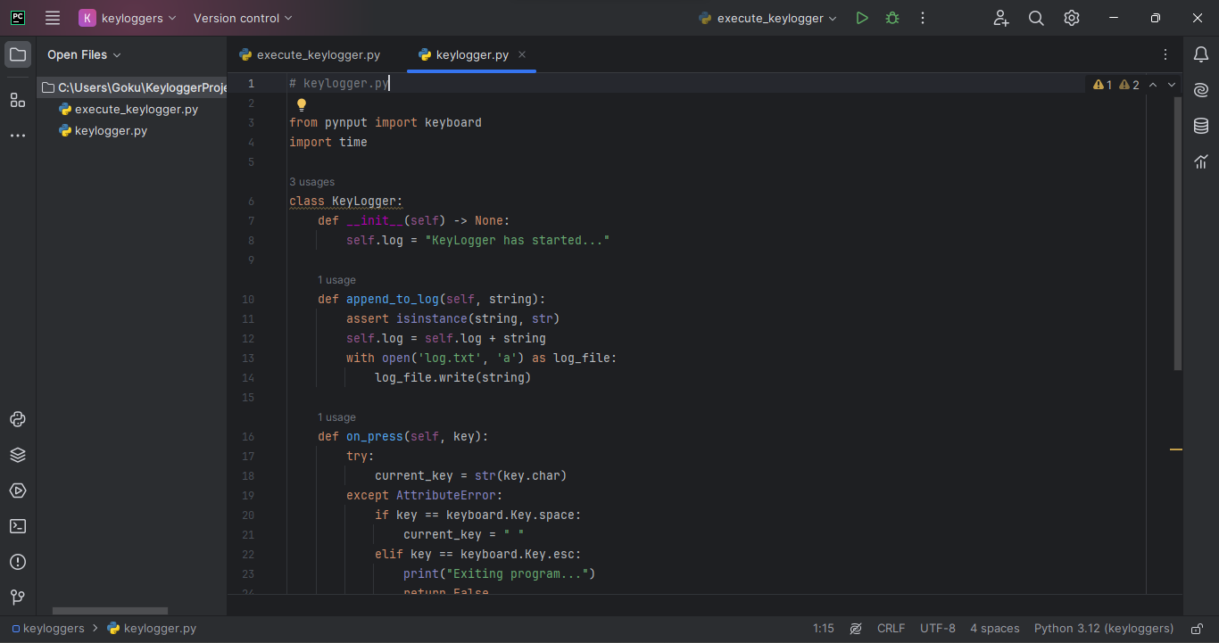
Codes
keylogger.py:

Slide 15
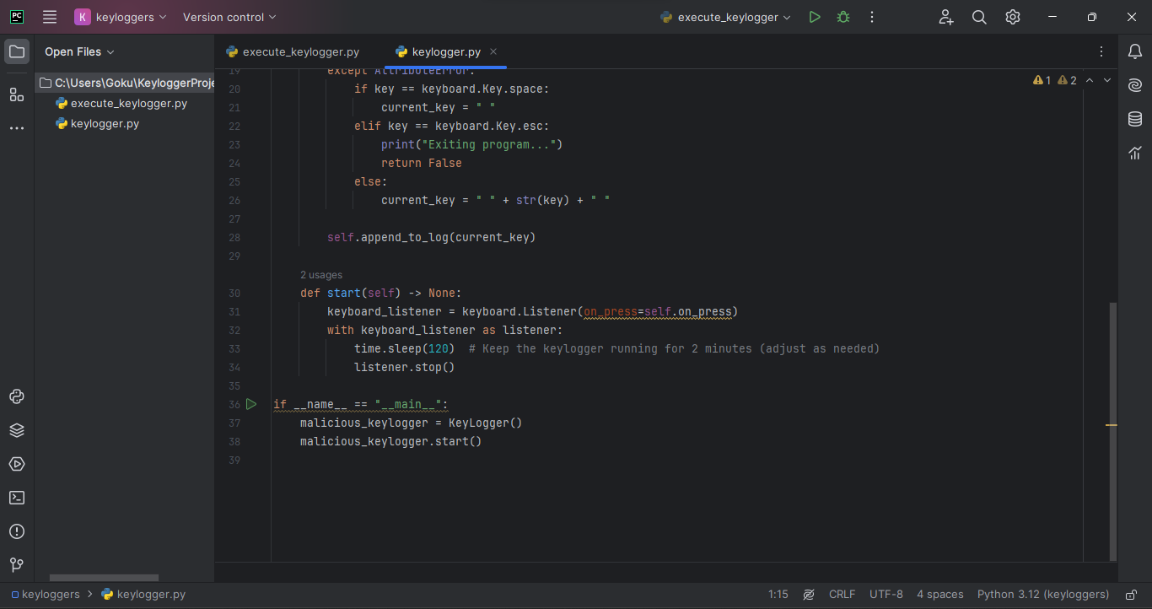
Codes
keylogger.py:

Slide 16
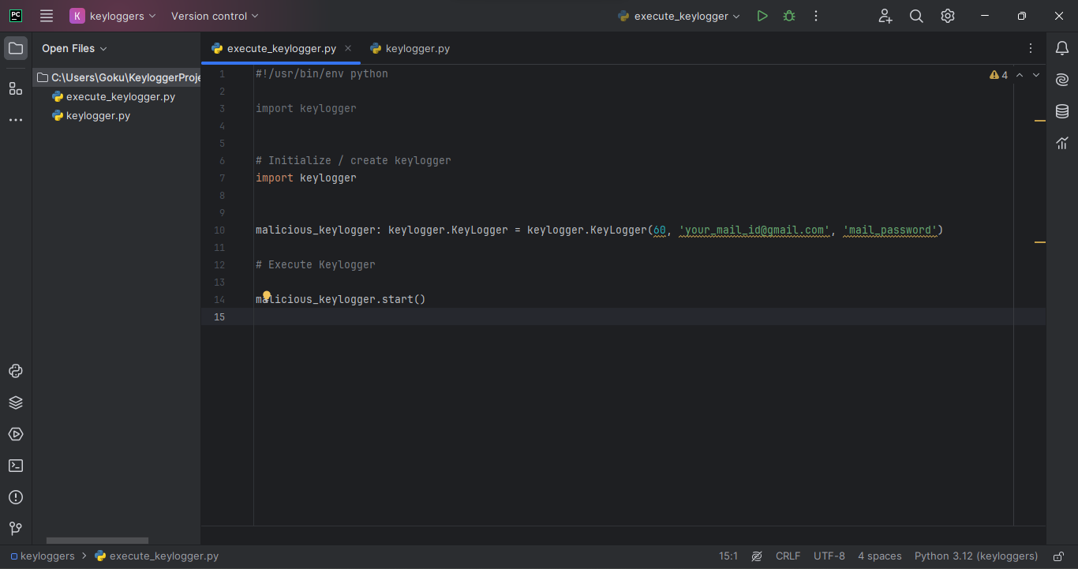
Codes
execute_keylogger.py

Slide 17
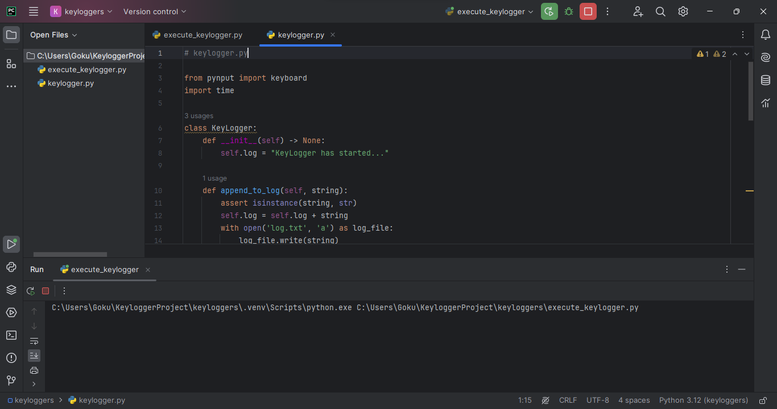
Codes
Run:

Slide 18
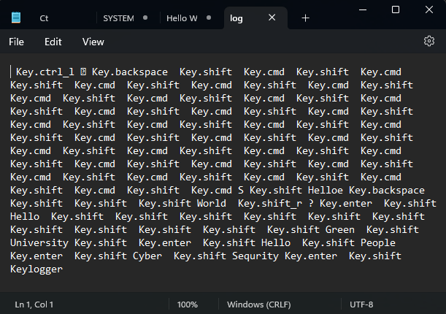
Output

Slide 19




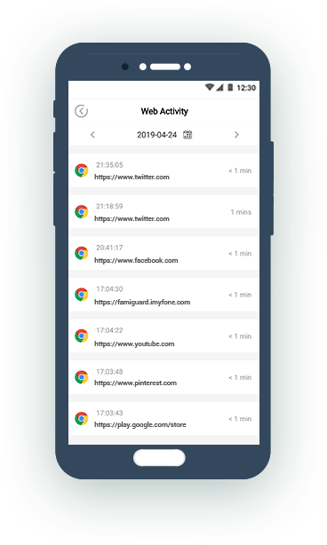
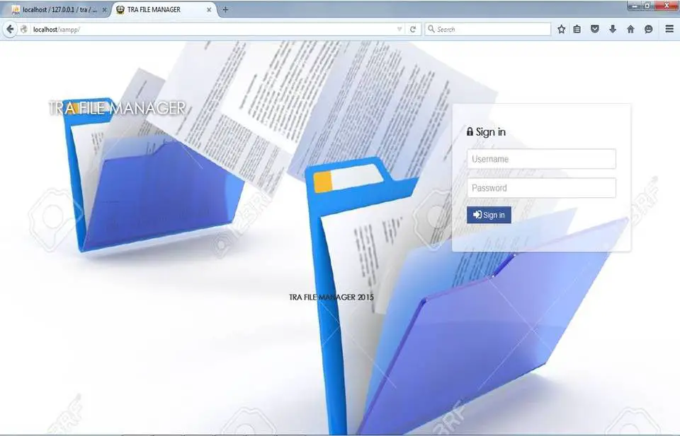

Advantages
Keystroke
Recording
Screenshot History
Remote Monitoring
Invisible mode & password protection
Web History logging
Application monitoring and file tracking
Email reports

Slide 20


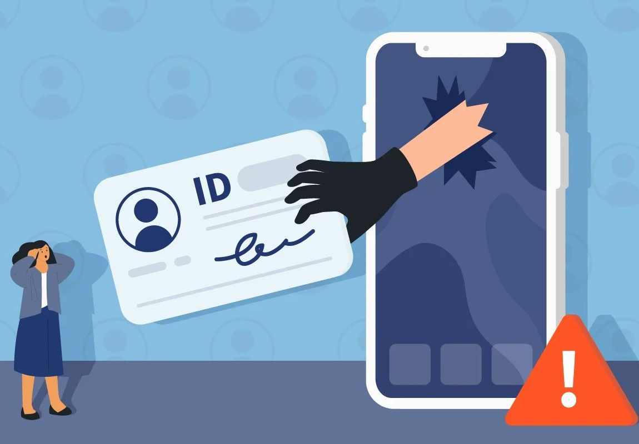



Disadvantages
Privacy Invasion
Data Breach
Identity Theft
Security Vulnerabilities
Financial Loss
Erosion of Trust

Slide 21
Conclusion
In summary, while keyloggers have legitimate uses like monitoring employee activities, there's a concerning rise in malicious applications stealing sensitive data. The use of rootkit technologies makes them hard to detect. It's crucial to stay vigilant by being cautious about installed software, practicing safe internet habits, and regularly updating computer software for enhanced cybersecurity.

Slide 22

Do You Have Any Questions ?

Slide 23

Thanks!

